Slide 1
Presentation on
BANK LOAN ANALYSIS PROJECT

Slide 2
Group 5
Ms. Pratiksha Kiran Kakade
Mr. Sriram Mandalapu
Mr. Shubham Vikas Mandlik
Miss. Rutuja Sunil Gunjal
Ms. Arpita Mohanty
Ms. Mrugaya Mahendra Bane

Slide 3
Objective of project
A comprehensive report on bank loan analysis was crafted to oversee and evaluate lending activities. Its purpose was to offer insights into crucial loan metrics and their fluctuations over time, facilitating data-driven decision-making, monitoring loan portfolio health, and pinpointing trends to inform lending strategies.

Slide 4
KPI’S
Year wise loan amount
Grade and subgrade wise Revol-bal
Total payment for verified and non verified loan status
State wise vs last credit pull wise loan status
Home ownership vs last payment date stats
Loan amount with respect to purpose
Top KPIs – Total loans issued, Total funded amount, Cumulative interest rate, Total recoveries

Slide 5
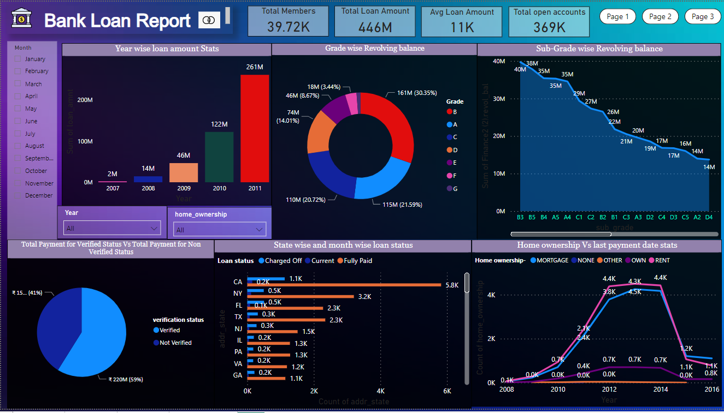
Dashboard

Slide 6
KPI 1 – Year wise loan amount
The data reveals a continuous rise in the overall loan amount disbursed by the bank from 2007 to 2011. This consistent uptrend implies an expansion in the bank's lending operations during this timeframe, highlighting either an increasing demand for loans or the bank's ability to attract borrowers.
Increase in loan amounts could also reflect market confidence
Additionally, exponential growth in loan amounts may suggest a phase of economic expansion or rising investment prospects within the specified years.

Slide 7
KPI 2 – grade and subgrade wise revol-balance
Category B holds the largest sum of $161,308,549 (161M), suggesting it accounts for a significant portion of the total revolving balance.
Categories A, B, & C have higher sum, which indicate they have greater amount in revolving balance, meaning better performance in credit utilization or loan distribution.
By comparing these sums over time or against other relevant metrics, trends in revolving balances across different categories can be identified. For instance, if Category B consistently maintains the highest sum over multiple periods, it may signify a consistent trend in credit utilization within that category.
Understanding which categories contribute the most to the total revolving balance can aid in more efficient resource allocation or in tailoring marketing strategies to target specific categories.

Slide 8
KPI 3 – Total payment for verified and non verified status
The increased total payment sum within the "Verified" category may suggest that customers or clients place greater trust and confidence in verified transactions, leading to larger payment amounts.
Larger payment amounts in verified transactions could imply lower risk, as verified accounts are more likely to fulfill their payment obligations compared to non-verified accounts.
Given the consistent occurrence of higher payment amounts in verified transactions, banks may prioritize and streamline their verification processes to optimize revenue and efficiency.
Discrepancies in payment amounts between verified and non-verified transactions may signal potential fraud or irregularities. Banks can utilize this insight to enhance fraud detection and prevention measures, such as implementing additional verification checks for high-value transactions.

Slide 9
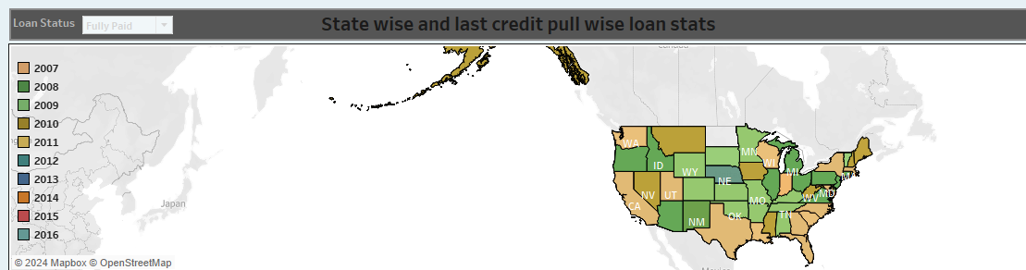
KPI 4 – State wise and last credit pull wise loan status
States with elevated counts of specific loan statuses may signal regions where borrowers encounter difficulties with loan repayment or where default rates are higher.
States with a higher count of adverse loan status may represent higher risk areas for lenders or financial institutions, necessitating closer monitoring and risk mitigation strategies.
States with a higher count of fully paid or current loan status may represent market opportunities for lenders, indicating areas where there is strong borrower performance and potential for further lending activity.
Lenders may tailor their product offerings or collection strategies based on the loan performance trends observed in different states, thereby optimizing customer engagement.

Slide 10
KPI 5 – Home ownership vs last payment date stats
Mortgage and rent ownership counts both reached their highest levels in 2013, indicating a potential peak in homeownership and rental demand during that year.
The lowest counts for mortgage, rent, and own ownership categories occurred in 2008, which aligns with the global financial crisis and the subsequent housing market downturn.
The increase in rent ownership alongside mortgage ownership in 2013 could suggest a combination of factors such as tighter lending standards, affordability concerns, or lifestyle preferences favoring renting over homeownership.

Slide 11
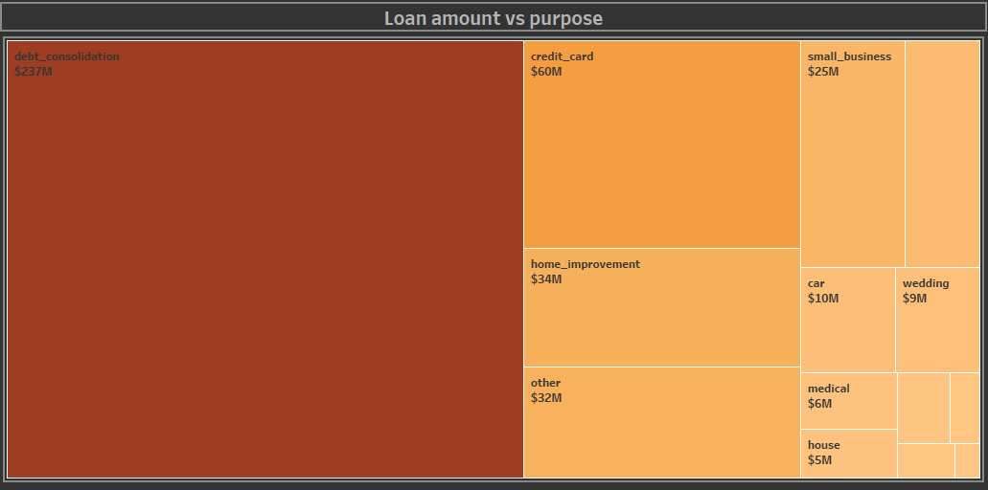
Kpi 6 – loan amount vs purpose
The data reveals that debt consolidation, credit card payments, and home improvement are among the most popular loan purposes, as they have the highest loan amounts. This suggests that borrowers often seek financing for these specific needs.
The significant loan amount for debt consolidation indicates that many borrowers are using loans to consolidate multiple debts into a single payment, potentially to simplify their finances or secure a lower interest rate.
The substantial loan amount for credit card payments suggests that consumers may be using personal loans to manage or pay off existing credit card debt. This could reflect consumer preferences for alternative forms of financing with potentially lower interest rates.
The notable loan amount for home improvement indicates that borrowers are investing in their properties, potentially to increase their home value or enhance living conditions
While the loan amount for educational purposes is comparatively lower, it still signifies investment in education and career advancement. Borrowers may be using loans to fund tuition fees, educational expenses, or skill development programs.

Slide 12
Kpi 6 – continued..
The loan amount for small business purposes suggests that some borrowers are using loans to start or expand small businesses. This insight is valuable for understanding entrepreneurship trends and supporting small business development.
Understanding the distribution of loan amounts across different purposes helps lenders assess market demand and develop targeted lending strategies.
Analysis of loan amounts by purpose can also inform risk management strategies for lenders. Certain loan purposes may carry higher or lower risk profiles, and lenders can adjust their underwriting criteria and risk assessment processes accordingly.

Slide 13
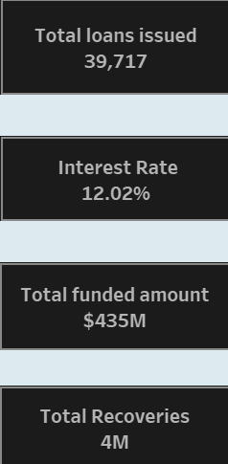
Top Kpi’s
The bank issued a total of 39,717 loans, indicating a significant level of lending activity. Analyzing the performance of this loan portfolio can provide insights into the bank's risk management practices, loan underwriting standards, and overall asset quality.
Despite issuing 39,717 loans, the total funded amount is $435 million, indicating that the bank efficiently leveraged its funding to support a substantial loan portfolio. This suggests effective capital allocation and management practices within the bank.
The cumulative interest rate of approximately 12% across the loan portfolio indicates the average interest rate charged on the loans. This insight is crucial for assessing the bank's interest income generation and profitability from lending activities.
The total recoveries from the loans amount to $4 million. Analyzing the recovery rate in relation to the total funded amount can provide insights into the bank's ability to effectively manage and collect on its loan portfolio. Higher recovery rates indicate effective collection strategies and loan management practices.
Assessing the overall performance of the loan portfolio, including the interest rates charged and the level of recoveries, provides insights into customer satisfaction and retention. Satisfied customers are more likely to repay their loans, resulting in higher recovery rates and reduced credit risk for the bank.

Slide 14
Conclusion
The number of loans issued increased steadily each year, with a slight decrease in 2008, with this settled loans, 83% were Fully Paid, while 14% were Charged Off.
The majority of loans originated from grades A, B, and C. There exists an inverse relationship between the interest rate and loan grade, with lower grades (E, F, G) having higher interest rates. Verified loan statuses outnumber non-verified ones; however, the bank cannot verify some loan applications due to various reasons.
The highest loan amount, reaching 237 million, was observed in the debit consolidation process compared to credit cards, small business loans, and others.

Slide 15
THANK YOU.

